Slide 1
ADHE Update
Sonia Hazelwood, Assistant Director
Arkansas Division of Higher Education
June 24, 2021

Slide 2
Arkansas Division of Higher Education Oh, All the Changes!
From Research & Analytics to…
Information Technology Function
Micah Gilbert, IT Manager
David Jones, CIO and SAD Team Lead
Beth Stewart, Senior Policy Analyst (under Director’s Office now)
Policy and Legislative Research
Productivity
Data Requests
Rachel Lewis, AHEIS Program Manager
Primary AHEIS contact for ALL institutions
Duties include file submission support and technical troubleshooting
Tracye McKeown, AHEIS Program Specialist
Ken Wall, AHEIS Database Administrator
Robert Crockett, Institutional Finance AHEIS Developer
Rich Sanders, Senior IT Manager
Please send all email to AHEIS@adhe.edu

Slide 5
Notes from the 2021 IPEDS Coordinators Workshop
Upload Custom Comparison Group for Data Feedback Reports by July 15, 2021
There are some minor changes for the 2021-22 data collection that will be communicated at the start of the data collection. These are changes intended for clarification purposes.
Prior Year Revisions – Fall and Winter surveys will be open for revision during their regular data collection period; Spring surveys will be open for revision during the Fall and Spring data collections
Revise cost of attendance data on Institutional Characteristics or any Student Financial Aid data through current year SFA, NOT in the Prior Year System
The U.S. Congress has shown renewed interest in reshaping the country’s postsecondary data collections with pending legislation in both the U.S. House and Senate that would create a Federal Student-Level Data Network (SLDN). For more information see the following publications:
https://www.ihep.org/publication/implementing-a-federal-student-level-data-network-advice-from-experts/
https://www.ihep.org/publication/implementing-a-student-level-data-network-part-ii-insights-from-institutional-representatives/
Notes:
Institute for Higher Education Policy

Slide 8
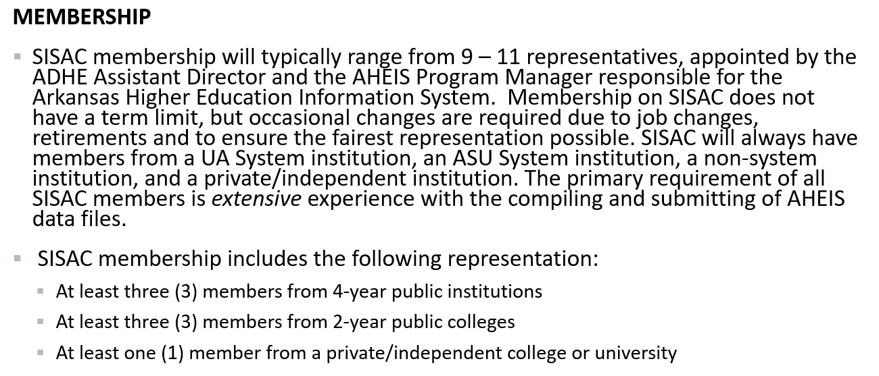

Slide 9
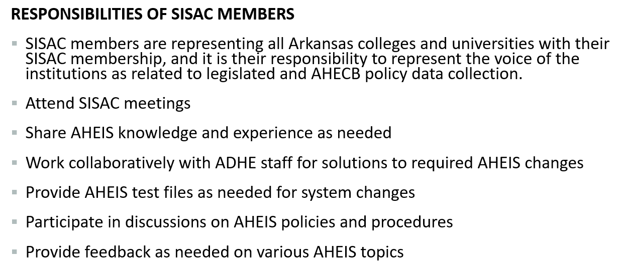

Slide 11
And the AHEIS Survey says…
AHEIS FT Passwords
FT Folder Sort Order
*Wish I could save my password in the browser
*Wish I could set my own FT password
*Sort files in folders with most recent first
AHEIS Manual
Error Report
Data Summaries
*Tabs were flimsy and eventually tore off
*Tabs would be nice
*What is LiveBinder?
*Every error report should include the primary key
*How do I tell which part of the term file contains the error?
*What are data summaries?
*I didn’t know they were available.
Notes:
ValID in error reports

Slide 12
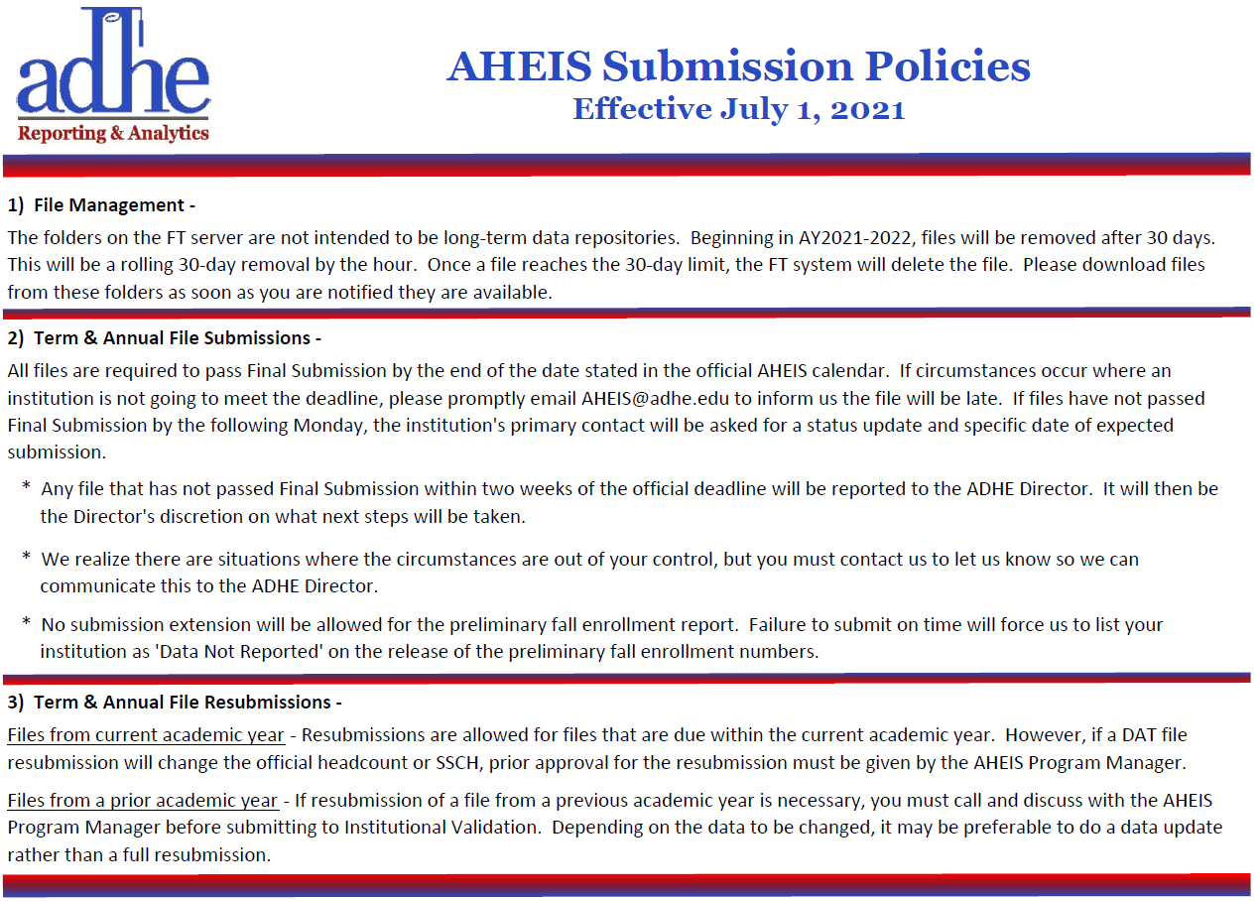
Notes:
Folder 3, 4, 5 and 6

Slide 13
Questions?
Sonia Hazelwood, Assistant Director
Arkansas Division of Higher Education
June 24, 2021

